Slide 1
DEVELOPMENT AND INHERITANCE
DEVELOPMENT AND IHERITANCE

Slide 2
DEVELOPMENT AND INHERITANCE
Developmental biology- is the study of the sequence of events from the fertilization of a secondary oocyte by a sperm cell to the formation of an adult organism.
Embryology- is the study of development from the fertilized egg through the eighth week.
The fetal period begins at week nine and continues until birth. During this time, the developing human is called a fetus.

Slide 3
DEVELOPMENT AND INHERITANCE
Pregnancy is a sequence of events that begins with fertilization, proceeds to implantation, embryonic development, and fetal development, and normally ends with birth about 38 weeks later, or 40 weeks after the last menstrual period.
Obstetrics is the branch of medicine that deals with the management of pregnancy, labor, and the neonatal period.

Slide 4
DEVELOPMENT AND INHERITANCE
Prenatal development is the time from fertilization to birth and includes both embryological and fetal development.
It is divided into three periods of three calendar months each, called trimesters.

Slide 5
EMBRYONIC PERIOD
OBJECTIVE.
Explain the major developmental events that occur during the embryonic period.

Slide 6
FIRST WEEK OF DEVELOPMENT
Characterized by several significant events including fertilization, cleavage of the zygote, blastocyst formation, and implantation.

Slide 7
FERTILIZATION
The genetic material from a haploid sperm cell (spermatozoon) and a haploid secondary oocyte merges into a single diploid nucleus.
Fertilization normally occurs in the uterine (fallopian) tube within 12 to 24 hours after ovulation.
Sperm can remain viable for about 48 hours after deposition in the vagina.

Slide 8
FERTILIZATION
Prostaglandins in semen are believed to stimulate uterine motility at the time of intercourse and to aid in the movement of sperm through the uterus and into the uterine tube.
During capacitation, sperm are acted upon by secretions in the female rep. tract that result in the removal of cholesterol, GP, and proteins from the plasma membrane around the head of the sperm.

Slide 9
FERTILIZATION
For fertilization to occur, a sperm cell ﬁrst must penetrate two layers:
1.Corona radiata(granulosa cells that surround the secondary oocyte)
2.Zona pellucida(clear glycoprotein layer between the corona radiata and the oocyte’s plasma membrane).
The acrosome- contains several enzymes.

Slide 10
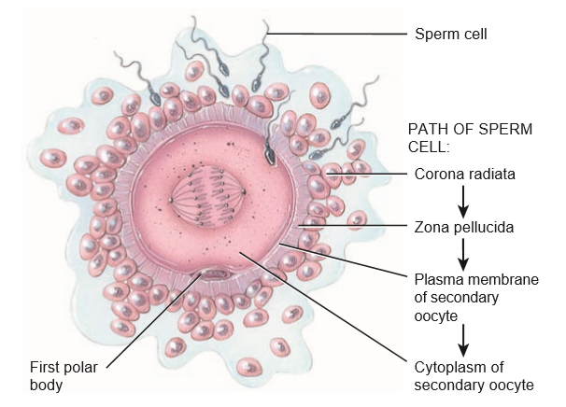
FERTILIZATION

Slide 11
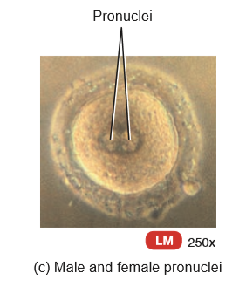
FERTILIZATION

Slide 12
FERTILIZATION
Acrosomal enzymes and strong tail movements by the sperm help it penetrate the cells of the corona radiata and come in contact with the zona pellucida.
One of the glycoproteins in the zona pellucida called ZP3 acts as a sperm receptor.
Its binding to speciﬁc membrane proteins in the sperm head triggers the acrosomal reaction, the release of the contents of the acrosome.

Slide 13
FERTILIZATION
The acrosomal enzymes digest a path through the zona pellucida.
Many sperm bind to ZP3 molecules and undergo acrosomal reactions.
However only the ﬁrst sperm cell to penetrate the entire zona pellucida and reach the oocyte’s plasma membrane fuses with the oocyte.

Slide 14
FERTILIZATION
Polyspermy-is the fertilization by more than one sperm cell.
Depolarization of secondary oocyte occurs immediately after fusion with first sperm occurs.
This acts as a fast block to polyspermy.
Depolarization also triggers the intracellular release of calcium ions, which stimulate exocytosis of secretory vesicles from the oocyte.

Slide 15
FERTILIZATION
The molecules released by exocytosis inactivate ZP3 and harden the entire zona pellucida, events called the slow block to polyspermy.
A secondary oocyte, the oocyte ﬁrst must complete meiosis II.
The nucleus in the head of the sperm develops into the male pronucleus, and the nucleus of the fertilized ovum develops into the female pronucleus.

Slide 16
FERTILIZATION
The fusion of the haploid (n) pronuclei restores the diploid number (2n) of 46 chromosomes(zygote).
Dizygotic (fraternal) twins are produced from the independent release of two secondary oocytes and the subsequent fertilization of each by different sperm.
monozygotic (identical) twins develop from a single fertilized ovum, they contain exactly the same genetic material and are always the same sex.

Slide 17
FERTILIZATION
Monozygotic twins arise from separation of the developing cells into two embryos, which in 99% of the cases occurs before 8 days have passed.
Separations that occur later than 8 days are likely to produce conjoined twins, a situation in which the twins are joined together and share some body structures.

Slide 18
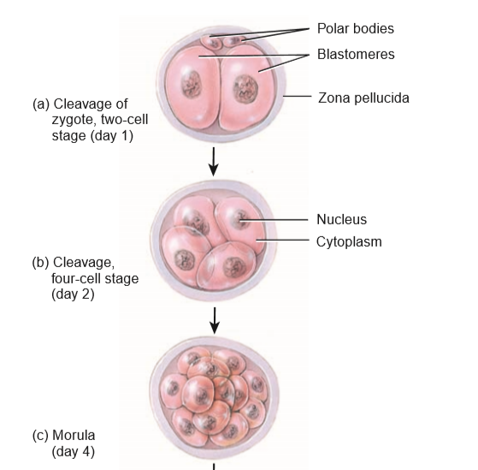
CLEAVAGE OF THE ZYGOTE

Slide 19
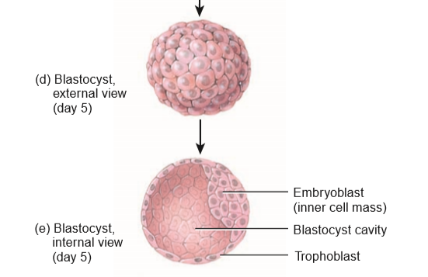
CLEAVAGE OF THE ZYGOTE

Slide 20
CLEAVAGE OF THE ZYGOTE
Cleavage-rapid mitotic cell divisions of the zygote.
The ﬁrst division of the zygote begins about 24 hours after fertilization and is completed about 6 hours later.
Each succeeding division takes slightly less time.
By the end of the third day, there are 16 cells.
Blastomeres-These are progressively smaller cells produced by cleavage.

Slide 21
CLEAVAGE OF THE ZYGOTE
Morula-a solid sphere of cells produced by Successive cleavages.
The morula is still surrounded by the zona pellucida and is about the same size as the original zygote.

Slide 22
BLASTOCYST FORMATION
By the end of the fourth day, the number of cells in the morula increases as it continues to move through the uterine tube toward the uterine cavity.
When the morula enters the uterine cavity on day 4 or 5, a glycogen-rich secretion from the glands of the endometrium of the uterus passes into the uterine cavity and enters the morula through the zona pellucida.

Slide 23
BLASTOCYST FORMATION
This ﬂuid(uterine milk) along with nutrients stored in the cytoplasm of the blastomeres of the morula, provides nourishment for the developing morula.
At the 32-cell stage, the ﬂuid enters the morula, collects between the blastomeres, and reorganizes them around a large ﬂuid-ﬁlled cavity called the blastocyst cavity/blastocoel.

Slide 24
BLASTOCYST FORMATION
Blastocyst(has hundreds of cells) but still about the same size as the original zygote.
During the formation of the blastocyst two distinct cell populations arise:
1.The embryoblast(inner cell mass)
2.Trophoblast(outer cell mass)- outer chorionic sac/fetal portion of the placenta

Slide 25
BLASTOCYST FORMATION
On about the ﬁfth day after fertilization, the blastocyst “hatches” from the zona pellucida by digesting a hole in it with an enzyme, and then squeezing through the hole.
This shedding of the zona pellucida is necessary in order to permit implantation to take place.

Slide 26
IMPLANTATION
The blastocyst remains free within the uterine cavity for about 2 days before it attaches to the uterine wall.
The endometrium is in its secretory phase.
Implantation-process by which the blastocyst loosely attaches to the endometrium at day 6.
Implantation-posterior portion of the fundus or the body of the uterus.

Slide 27
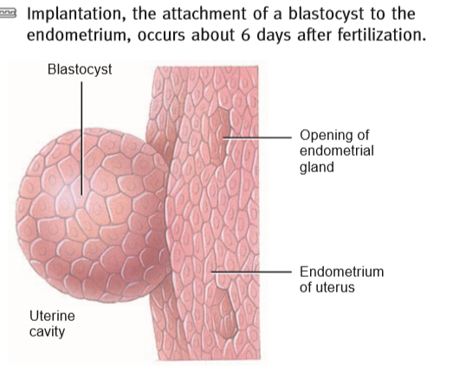
RELATION OF A BLASTOCYST TO THE ENDOMETRIUM OF THE UTERUS AT THE TIME OF IMPLANTATION.

Slide 28
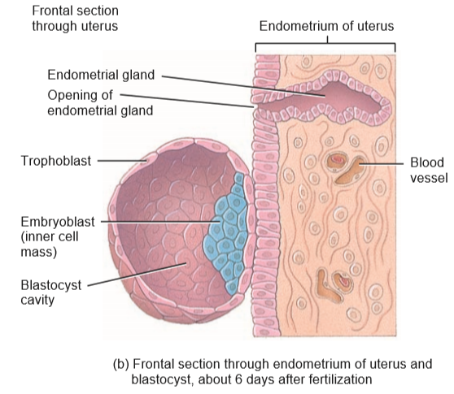
FRONTAL SECTION THROUGH ENDOMETRIUM OF UTERUS AND BLASTOCYST,ABOUT 6 DAYS AFTER FERTILIZATION

Slide 29
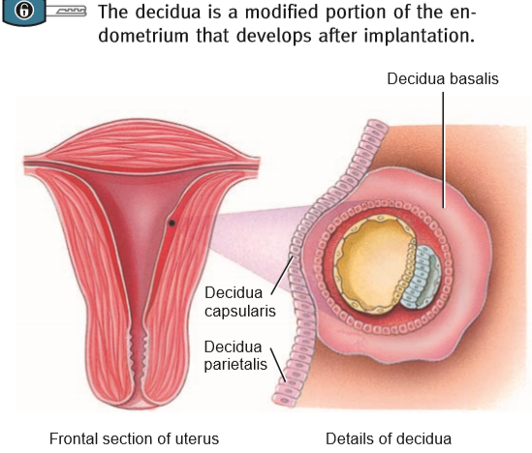
REGIONS OF THE DECIDUA.

Slide 30
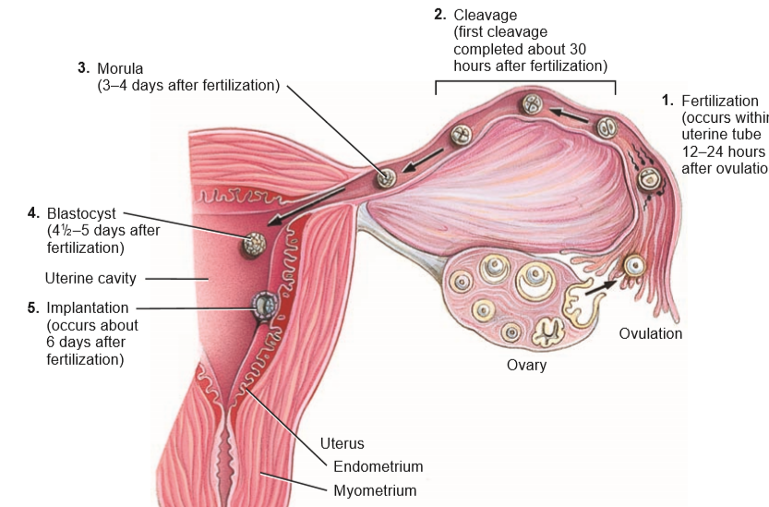
SUMMARY OF EVENTS ASSOCIATED WITH THE ﬁRST WEEK OF DEVELOPMENT.

Slide 31
IMPLANTATION
Implantation-it orients with the inner cell mass toward the endometrium.
About seven days after fertilization, the blastocyst attaches to the endometrium more ﬁrmly, endometrial glands in the vicinity enlarge, and the endometrium becomes more vascularized.

Slide 32
IMPLANTATION
The blastocyst eventually secretes enzymes and burrows into the endometrium and becomes surrounded by it.
Decidua-endometrium following implantation.
Decidua basalis -is the portion of the endometrium between the embryo and the stratum basalis of the uterus.

Slide 33
IMPLANTATION
It provides large amounts of glycogen and lipids for the developing embryo and fetus and later becomes the maternal part of the placenta.
Decidua capsularis- is the portion of the end. located between the embryo and the uterine cavity. As the embryo and fetus enlarges, the decidua capsularis bulges into the uterine cavity and fuses with the decidua parietalis obliterating the uterine cavity

Slide 34
IMPLANTATION
By about 27 weeks, the decidua capsularis degenerates and disappears.

Slide 35
CLINICAL CONNECTION
Stem cells are unspecialized cells that have the ability to divide for indeﬁnite periods and give rise to specialized cells.
A zygote is known as a totipotent stem cell(potential to form an entire organism).
Inner cell mass cells is called pluripotent stem cells(can give rise to many (but not all) different types of cells).

Slide 36
CLINICAL CONNECTION
Multipotent stem cells(pluripotent stem cells that has undergone further specialization)- stem cells with a speciﬁc function.
Therapeutic cloning is envisioned as a procedure in which the genetic material of a patient with a particular disease is used to create pluripotent stem cells to treat the disease.

Slide 37
CLINICAL CONNECTION
Adult stem cells— are stem cells that remain in the body throughout adulthood.
Studies have suggested that stem cells in human adult red bone marrow have the ability to differentiate into cells of the liver, kidney, heart, lung, skeletal muscle, skin, and organs of the gastrointestinal tract.
Ectopic pregnancy- is the development of an embryo or fetus outside the uterine cavity.

Slide 38
CLINICAL CONNECTION
Women who smoke are twice as likely to have an ectopic pregnancy because nicotine in cigarette smoke paralyzes the cilia in the lining of the uterine tube.

Slide 39
QUESTIONS
1.Where does fertilization normally occur?
2.How is polyspermy prevented?
3.What is a morula, and how is it formed?
4.Describe the layers of a blastocyst and their eventual fates.
4.When, where, and how does implantation occur?

Slide 40
SECOND WEEK OF DEVELOPMENT
SECOND WEEK OF DEVELOPMENT

Slide 41
DEVELOPMENT OF THE TROPHOBLAST
About 8 days after fertilization trophoblast develops into two layers in the region of contact between the blastocyst and endometrium.
Syncytiotrophoblast-contains no distinct cell boundaries.secrete enzymes
Cytotrophoblast-located between the embryoblast and syncytiotrophoblast and is composed of distinct cells.

Slide 42
DEVELOPMENT OF THE TROPHOBLAST
The two layers of trophoblast become part of the chorion (one of the fetal membranes).
Blastocyst becomes buried in the endometrium and inner one-third of the myometrium.
Trophoblast-secrete HCG.
Human chorionic gonadotropin rescues the corpus luteum from degeneration and sustains its secretion of progesterone and estrogens.

Slide 43
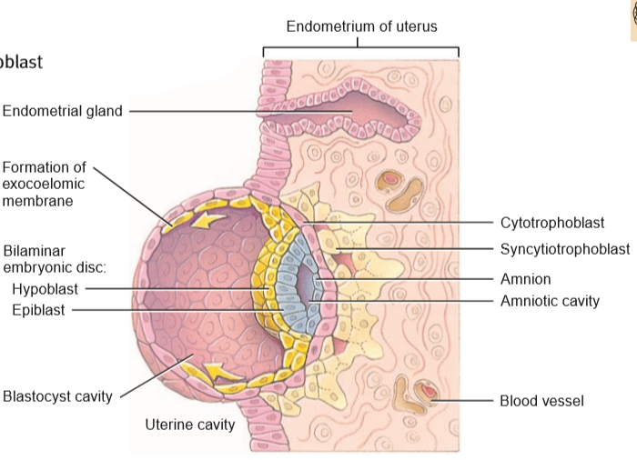
FRONTAL SECTION THROUGH ENDOMETRIUM OF UTERUS SHOWING BLASTOCYST, ABOUT 8 DAYS AFTER FERTILIZATION

Slide 44
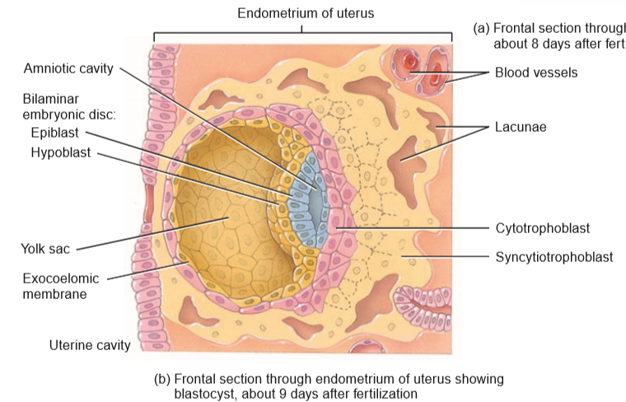
FRONTAL SECTION THROUGH ENDOMETRIUM OF UTERUS SHOWING BLASTOCYST, ABOUT 9 DAYS AFTER FERTILIZATION

Slide 45
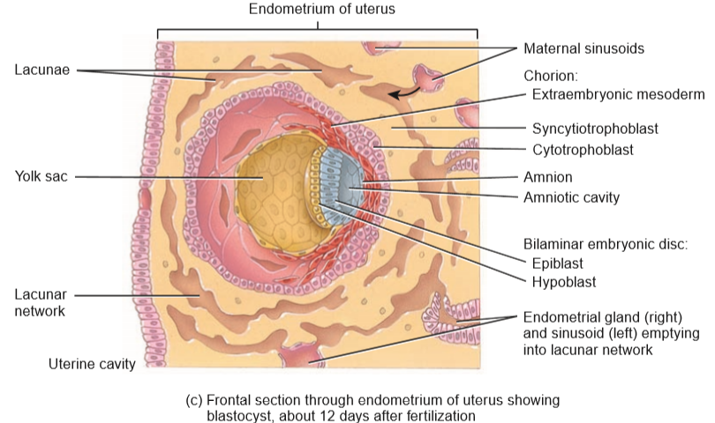
FRONTAL SECTION THROUGH ENDOMETRIUM OF UTERUS SHOWING BLASTOCYST,ABOUT 12 DAYS AFTER FERTILIZATION

Slide 46
DEVELOPMENT OF THE TROPHOBLAST
Peak secretion of hCG occurs about the ninth week of pregnancy at which time the placenta is fully developed and produces the progesterone and estrogens that continue to sustain the pregnancy.

Slide 47
DEVELOPMENT OF THE BILAMINAR EMBRYONIC DISC
Cells of the embryoblast also differentiate into two layers around 8 days after fertilization:
1.A hypoblast (primitive endoderm).
2.An epiblast (primitive ectoderm).
Cells of the hypoblast and epiblast together form a ﬂat disc referred to as the bilaminar embryonic disc.
amniotic cavity-cavity appears within the epiblast.

Slide 48
DEVELOPMENT OF THE AMNION.
As the amniotic cavity enlarges, a single layer of squamous cells forms a dome-like roof above the epiblast cells called the amnion.
Amnion forms the roof of the amniotic cavity.
Epiblast forms the ﬂoor of the amniotic cavity.
Initially, the amnion overlies only the bilaminar embryonic disc.

Slide 49
DEVELOPMENT OF THE AMNION
As the embyonic disc increases in size and begins to fold, the amnion eventually surrounds the entire embryo creating the amniotic cavity that becomes ﬁlled with amniotic ﬂuid.
Amniotic ﬂuid-maternal blood,foetal urine.
Amniotic ﬂuid-a shock absorber for the fetus,regulate fetal body temperature,prevent the fetus from drying out,prevents adhesions between the skin of the fetus and surrounding tissues.

Slide 50
DEVELOPMENT OF THE AMNION
“Bag of waters.”
Amniocentesis.

Slide 51
DEVELOPMENT OF THE YOLK SAC
On the eighth day after fertilization, cells at the edge of the hypoblast migrate and cover the inner surface of the blastocyst wall.
The migrating columnar cells become squamous (ﬂat) and then form a thin membrane referred to as the exocoelomic membrane.
Yolk sac(former blastocyst cavity)- formed by hypoblast together with exocoelomic membrane.

Slide 52
DEVELOPMENT OF THE YOLK SAC
Bilaminar embryonic disc is now positioned between the amniotic cavity and yolk sac.
Since human embryos receive their nutrients from the endometrium, the yolk sac is relatively empty, small and decreases in size as development progresses.
Yolk sac-supplies nutrients to the embryo during the second and third weeks of development; is the source of blood cells from the third through sixth weeks.

Slide 53
DEVELOPMENT OF THE YOLK SAC
Yolk sac- contains the ﬁrst cells (primordial germ cells) that will eventually migrate into the developing gonads, differentiate into the primitive germ cells, and form gametes; forms part of the gut (gastrointestinal tract); functions as a shock absorber; and helps prevent drying out of the embryo.

Slide 54
DEVELOPMENT OF SINUSOIDS
On the ninth day after fertilization, the blastocyst becomes completely embedded in the endometrium.
As the syncytiotrophoblast expands, small spaces called lacunae develop within it.
By the twelfth day of development, the lacunae fuse to form larger, interconnecting spaces called lacunar networks.

Slide 55
DEVELOPMENT OF SINUSOIDS
Endometrial capillaries around the developing embryo become dilated and are referred to as maternal sinusoids.
As the syncytiotrophoblast erodes some of the maternal sinusoids and endometrial glands, maternal blood and secretions from the glands enter the lacunar networks and ﬂow through them.

Slide 56
DEVELOPMENT OF SINUSOIDS
Maternal blood is both a rich source of materials for embryonic nutrition and a disposal site for the embryo’s wastes.

Slide 57
DEVELOPMENT OF THE EXTRAEMBRYONIC COELOM.
About the twelfth day after fertilization, the extraembryonic mesoderm develops.
They are derived from the yolk sac and form a connective tissue layer (mesenchyme) around the amnion and yolk sac.
Soon a number of large cavities develop in the extraembryonic mesoderm, which then fuse to form a single, larger cavity called the extraembryonic coelom.

Slide 58
DEVELOPMENT OF THE CHORION
The extraembryonic mesoderm, together with the two layers of the trophoblast (the cytotrophoblast and syncytiotrophoblast) form the chorion.
The chorion surrounds the embryo and later, the fetus.
Eventually it becomes the principal embryonic part of the placenta.

Slide 59
DEVELOPMENT OF THE CHORION
The chorion also protects the embryo and fetus from the immune responses of the mother in two ways:
It secretes proteins that block antibody production by the mother.
(2) It promotes the production of T lymphocytes that suppress the normal immune response in the uterus.
(3)produces human chorionic gonadotropin (hCG).

Slide 60
DEVELOPMENT OF THE CHORION
The inner layer of the chorion eventually fuses with the amnion.
With the development of the chorion, the extraembryonic coelom is now referred to as the chorionic cavity.
The bilaminar embryonic disc becomes connected to the trophoblast by a band of extraembryonic mesoderm called the connecting (body) stalk.

Slide 61
DEVELOPMENT OF THE CHORION
The connecting stalk is the future umbilical cord.

Slide 62
QUESTIONS
1.What are the functions of the trophoblast?
2.How is the bilaminar embryonic disc formed?
3.Describe the formation of the amnion, yolk sac, and chorion and explain their functions.
4.Why are sinusoids important during embryonic development?

Slide 63
THE END
THANK YOU

